Slide 1

Inferential Statistics

Slide 2

Inferential Statistics
Inferential Statistics
Parameter Estimate
Hypothesis Testing

Slide 3
Inferential Statistics
Inferential Statistics
Parameter Estimate
Hypothesis Testing
Today's Topic

Slide 4

Parameter Estimates

Slide 5
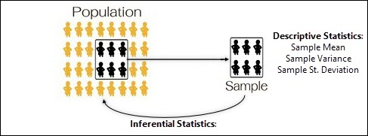
Populations, Samples & Inferential Statistics
Inferential statistics is a collection of methods that allow us to make inferences about a population based on information obtained from a sample of data.
Within statistics, a Population is defined as a total set of objects, events or observations about which you want to study.
We’re often interested in knowing the mean & standard deviation associated with populations we’re dealing with.
However, we rarely have the time or resources to measure all values associated with our populations, which is where sampling helps us.

Slide 6
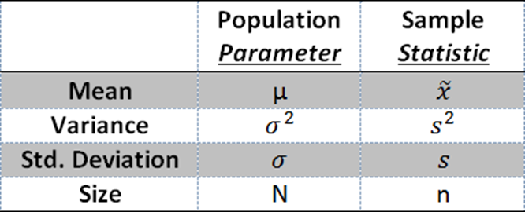
Statistic vs. Parameter.
When we talk about sample data and we calculate the mean or standard deviation, we are calculating a Statistic.
Statistics are associated with Samples.
When we talk about entire population and we calculate the mean or standard deviation, we are calculating a Parameter.
Parameter are associated with Population.

Slide 7
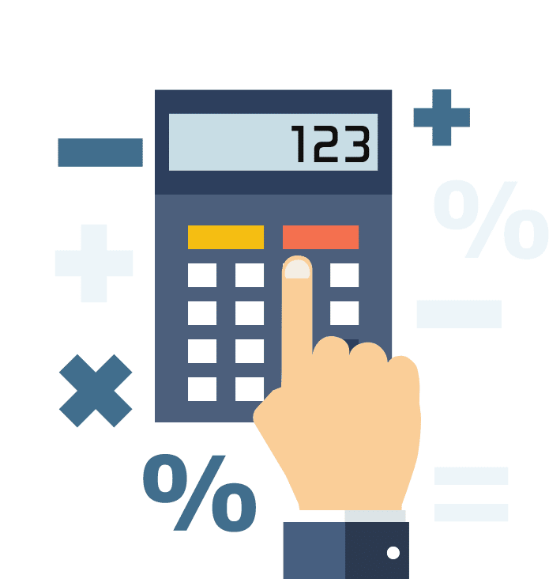
Parameters, Statistics & Estimates
In inferential statistics, we take our sample data, and we calculate our sample statistics.
We can then use those sample statistics to estimate the population parameter; which is often what we’re really looking to understand.
These sample statistics are used within this concept of an estimate, where there are two types of estimates:
Point Estimates
Interval Estimates.

Slide 8
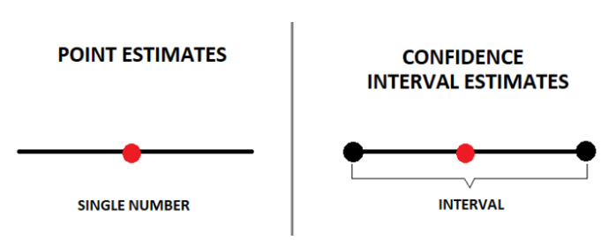
Parameter Estimates
The characteristics of samples and populations are described by numbers called statistics and parameters:
There are two important types of estimates you can make about the population: point estimates and interval estimates.
Point Estimate is a single value estimate of a parameter. For instance, a sample mean is a point estimate of a population mean.
Interval Estimate gives you a range of values where the parameter is expected to lie. A confidence interval is the most common type of interval estimate.

Slide 9

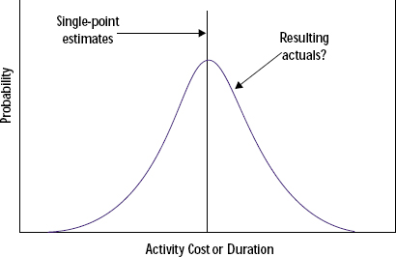
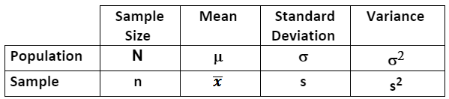
Parameter Estimates Point Estimate
In statistics, Point Estimation involves the use of sample data to calculate a single value which is to serve as a "best guess" or "best estimate" of an unknown population parameter.
Notes:
Source: https://pmi-p-001.sitecorecontenthub.cloud/api/public/content/db9e54346fb04911bd7b086d54ed85f2?v=d8cc7699

Slide 10
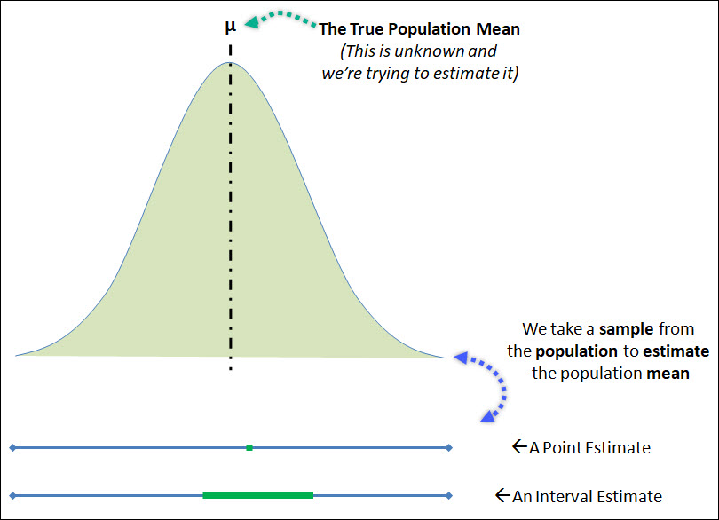
Parameter Estimates Interval Estimate
A confidence interval uses the variability around a statistic to come up with an interval estimate for a parameter. Confidence intervals are useful for estimating parameters because they take sampling error into account.
A 95% confidence interval means that if you repeat your study with a new sample in the same way 100 times, you can expect your estimate to lie within the specified range of values 95 times.
Notes:
Source: https://cqeacademy.com/wp-content/uploads/2017/12/Point-Estimate-Interval-Estimate.jpg

Slide 11
Point Estimates

Slide 12
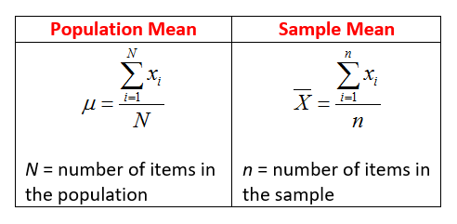
Point Estimate for the Population Mean
Point estimate of the mean of a population is determined by calculating the mean of a sample drawn from the population.
The calculation of the mean is the sum of all sample values divided by the number of values.
Notes:
Source: https://lh5.googleusercontent.com/U5t1myQqWs_VbtzwQY0yKKo5W3LXnaAsLxv6yEsR-MShZECEmtIomVQ96higKVm_duBeyVujk3mG_4M9RK9TRhOoM3P4GevxdiVjkObrarEKIL_NAMsq2WK2SGRwffx6K6vsjlnC

Slide 13
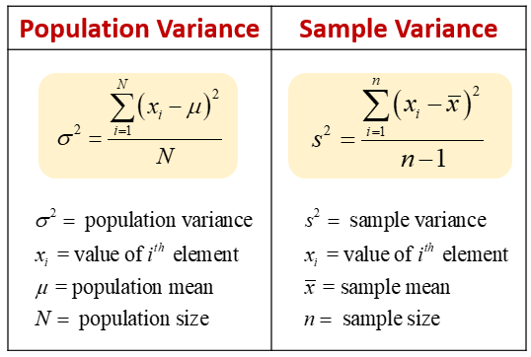
Point Estimate for the Population Variance & Standard Deviation
The point estimate of the population variance & standard deviation is simply the sample variance & sample standard deviation
Notes:
Source: https://lh3.googleusercontent.com/5yB06vJnguZ1IP5e1aSahrPqfUm71YzjaV66lJqI2QlR_pWDcY5ZIZ5898W4cDaPIXSQU9MWRn0ySxtCZ_nVqbqBIkoVdl4Epc1wdtilI3dpCFZXd3t4MKhoV8Yw-KuKmzWSF57w

Slide 14
Interval Estimates

Slide 15
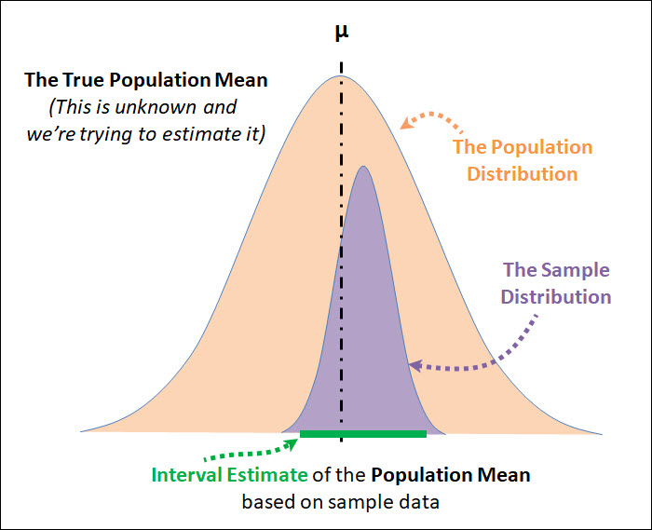
Confidence Interval (The Interval Estimate)
An interval estimate is a type of estimation that uses a range (or interval) of values, based on sampling information, to “capture” or “cover” the true population parameter being inferred / estimated.
Interval estimates are created using a confidence level, which is the probability that your interval truly captures the population parameter being estimated.
Because we use a confidence level, we often call these interval estimates a confidence interval.
Notes:
Source: https://lh5.googleusercontent.com/U5t1myQqWs_VbtzwQY0yKKo5W3LXnaAsLxv6yEsR-MShZECEmtIomVQ96higKVm_duBeyVujk3mG_4M9RK9TRhOoM3P4GevxdiVjkObrarEKIL_NAMsq2WK2SGRwffx6K6vsjlnC

Slide 16
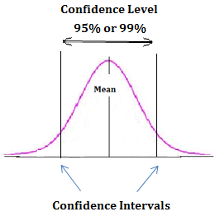
What does a Confidence Level Mean?
The confidence level is an often misunderstood concept.
When we say that we have 95% confidence in our interval estimate, we do not mean that 95% of the overall population falls within the confidence interval.
The confidence level is the probability that your confidence interval truly captures the population parameter being estimated.
So, if we have a 95% confidence level, we can be confident that 95% of the time (95 out of 100), our interval estimate will accurately capture the true parameter being estimated.
Notes:
Source: https://www.whatissixsigma.net/wp-content/uploads/2014/05/Confidence-Interval.png

Slide 17
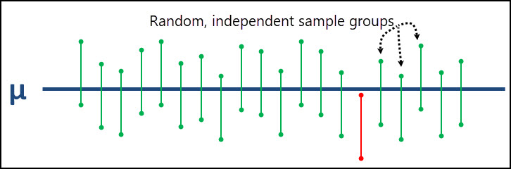
What does a Confidence Level Mean?
If you look at the graph below, the true population parameter (μ in this case) is shown as the solid blue line down the middle.
In 19 of the 20 intervals created, the true population mean is captured within those 19 intervals.
There is only 1 interval that does not capture the true population mean and it’s shown in red.
Notes:
Source: https://cqeacademy.com/wp-content/uploads/2017/12/Confidence-Interval-Interpretation.jpg

Slide 18
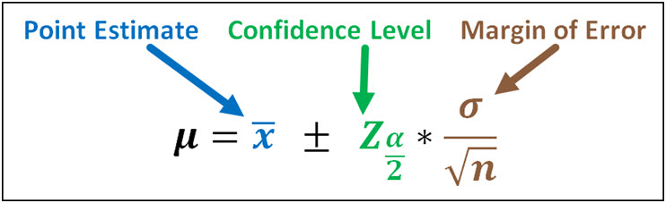
The Confidence Interval Equation
The confidence interval equation is comprised of 3 parts: a point estimate (also sometimes called a sample statistic), a confidence level, and a margin of error.
The point estimate, or statistic, is the most likely value of the population parameter and the confidence level & margin of error represents the amount of uncertainty associated with the sample taken.
Confidence Interval = Point Estimate + Confidence Level * Margin of Error
When dealing with the population mean, the confidence interval looks like this:
Notes:
You’ll notice that the margin of error for the population mean is equal to the standard error.
The standard error can be impacted by the sample size (n) associated with your sample, where a larger sample means a smaller margin of error. The margin of error is also impacted by the standard deviation.

Slide 19
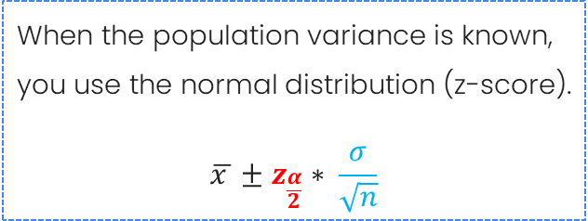
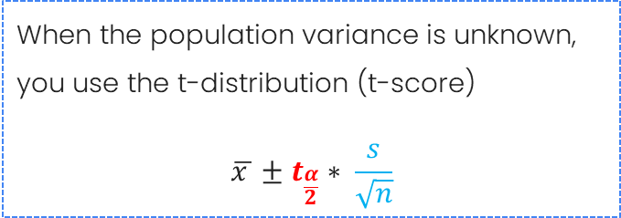
Confidence Interval for Population Mean
These two possible equations are based on whether the population variance is known or unknown.
Generally, if the sample size is less than 30, the t-distribution should be used. If the sample size is greater than 30, then the normal distribution can be used.

Slide 20
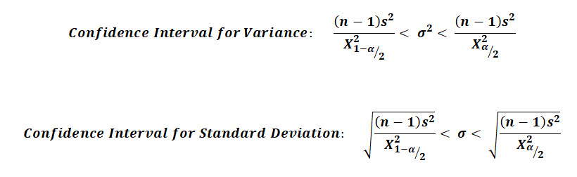
Confidence Interval for Population Variance & Standard Deviation
One key difference with this equation when compared against the ones for the population mean, is that these confidence intervals are not symmetric.
Notes:
Source: https://cqeacademy.com/wp-content/uploads/2017/12/Confidence-Intervals-for-Population-Variance-and-Population-Standard-Deviation.jpg

Slide 21
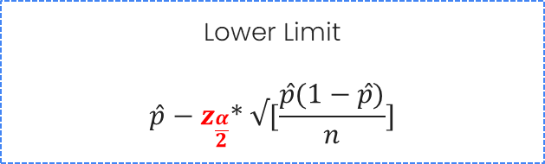

Confidence Interval for Population Proportion
Proportion confidence intervals estimate the range within which the true proportion lies. Use normal approximation when sample size is large enough.
.
Notes:
Source: https://cqeacademy.com/wp-content/uploads/2017/12/Confidence-Intervals-for-Population-Variance-and-Population-Standard-Deviation.jpg

Slide 22
Confidence Interval for Population Variance & Standard Deviation
One key difference with this equation when compared against the ones for the population mean, is that these confidence intervals are not symmetric.
Notes:
Source: https://cqeacademy.com/wp-content/uploads/2017/12/Confidence-Intervals-for-Population-Variance-and-Population-Standard-Deviation.jpg

Slide 23
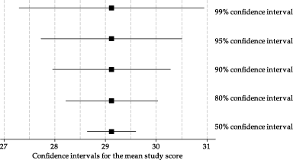
Factors Affecting Confidence Interval Width
Confidence level
(higher confidence = wider interval)
Sample size
(larger sample = narrower interval)
Population variability
(greater variability = wider interval)
Sampling method
Narrower but riskier…!
Wider but Safer ;)

Slide 24
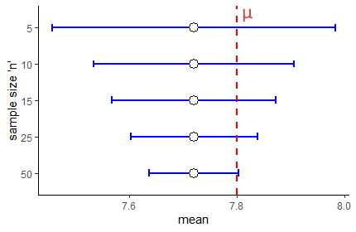
Sample Size Considerations
Why Sample Size Matters…?
Ensures accurate representation of the population
Reduces sampling error
Increases precision of estimates
Enhances the power of statistical tests

Slide 25
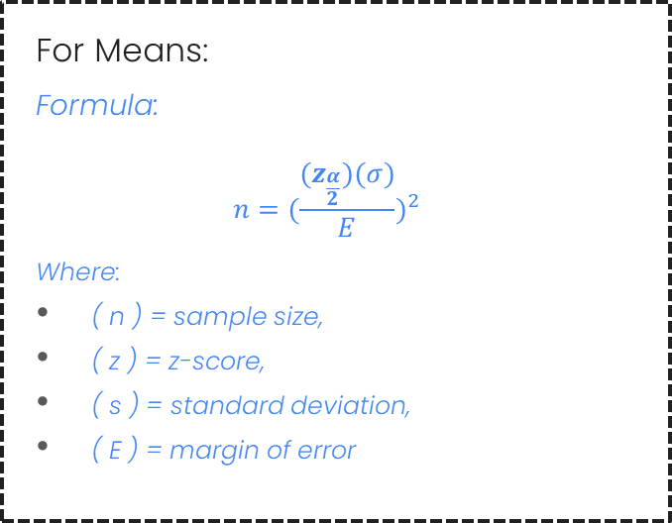
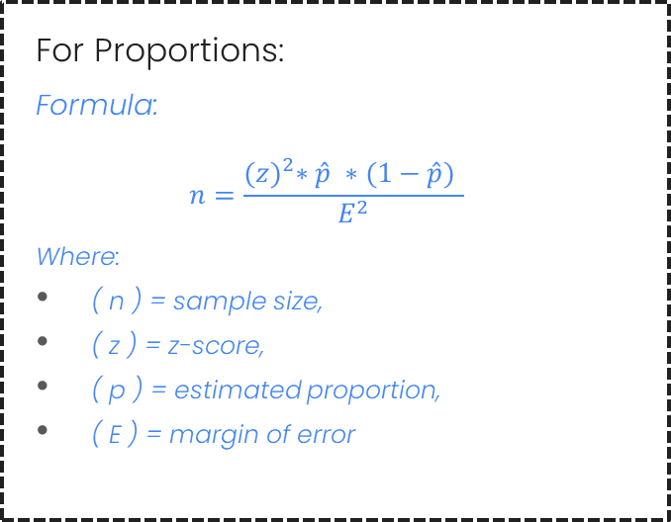
Sample Size Determination Formulas

Slide 26
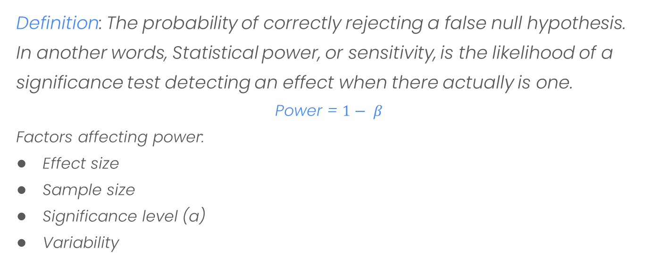
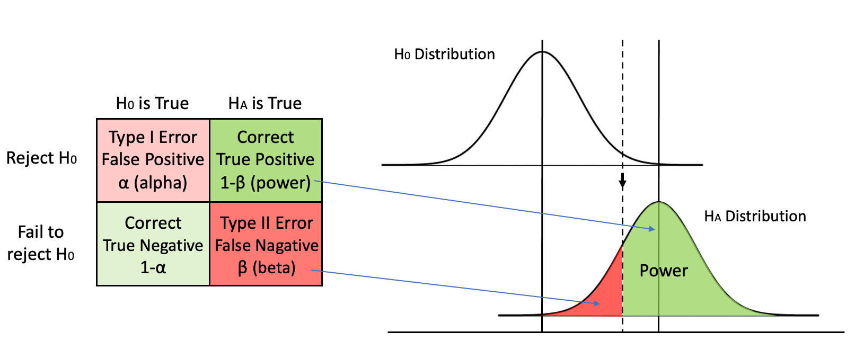
Statistical Power

Slide 27


Slide 28
To be Continued…

